Slide 1



TalentHub
TalentHub
Team Members:
Technical Provider:
Eslam Ehab Elnady
Eslam Elsayed Elshahat
Moaaz Ahmed Mohamed
Abdelrahman Hassan Shawer
AST

Slide 2
TalentHub
Find Your Gold Player Here
Introduction
TalentHub is an application to help the unknown talents which are younge football player to be seen and to get in contact with the scouts of big and small football clubs.
Talent
Hub

Slide 3

TalentHub
Authentication
Main
Upload video
Features
Likes and Comments
Chat
Firebase

Slide 4
TalentHub
OnBoarding & Authentication

Slide 5

TalentHub
Onboarding by Moaaz Ahmed
Onboarding
The applications starts with onboarding screen after the splash screen. In this screen we can see that the user can either create an account or login if he has an account.

Slide 6
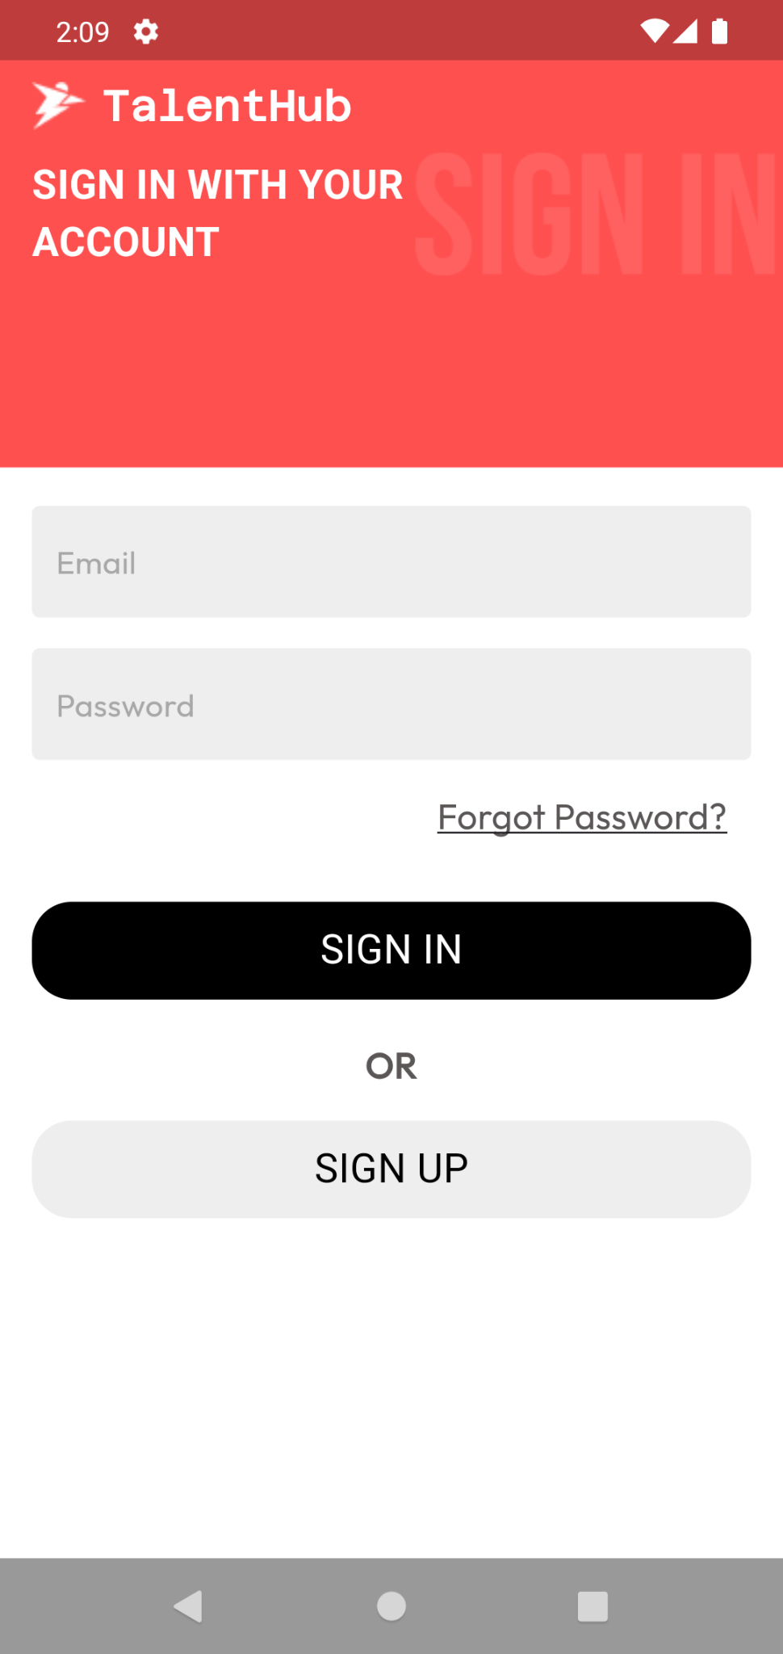
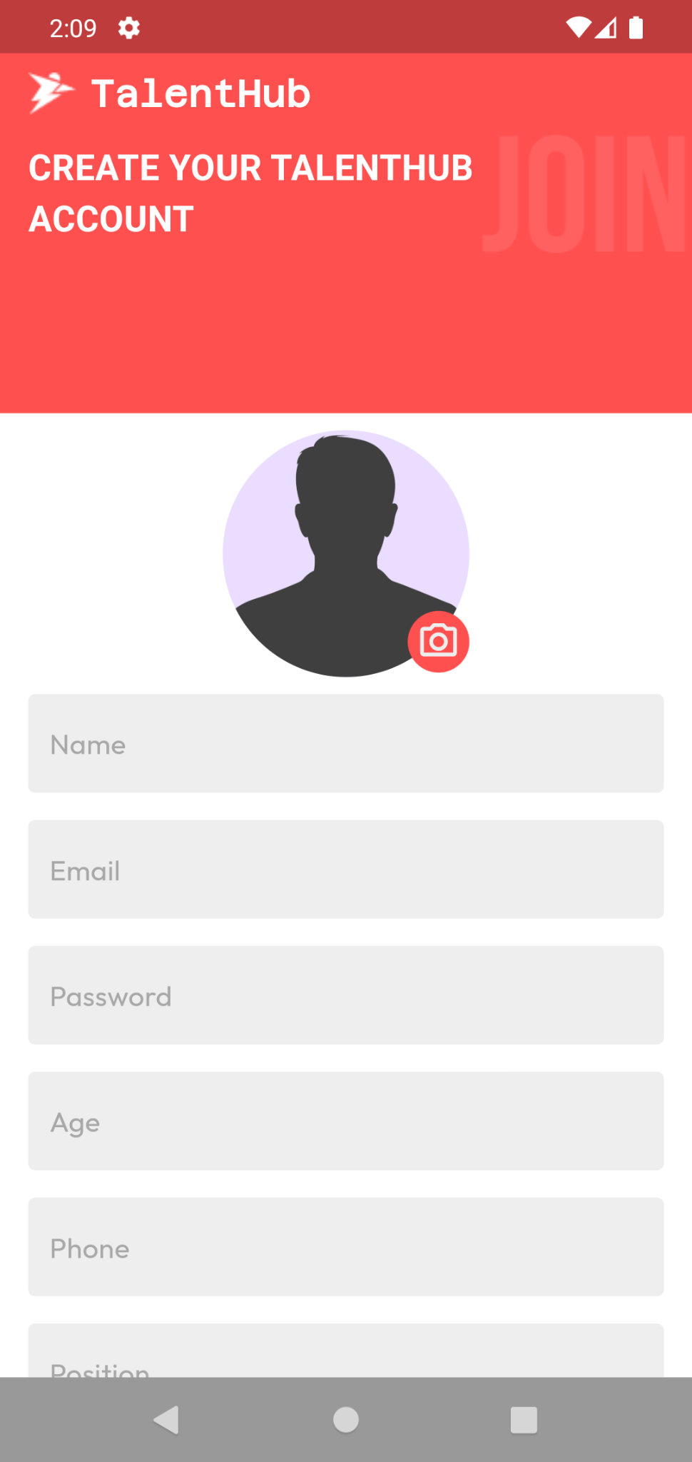
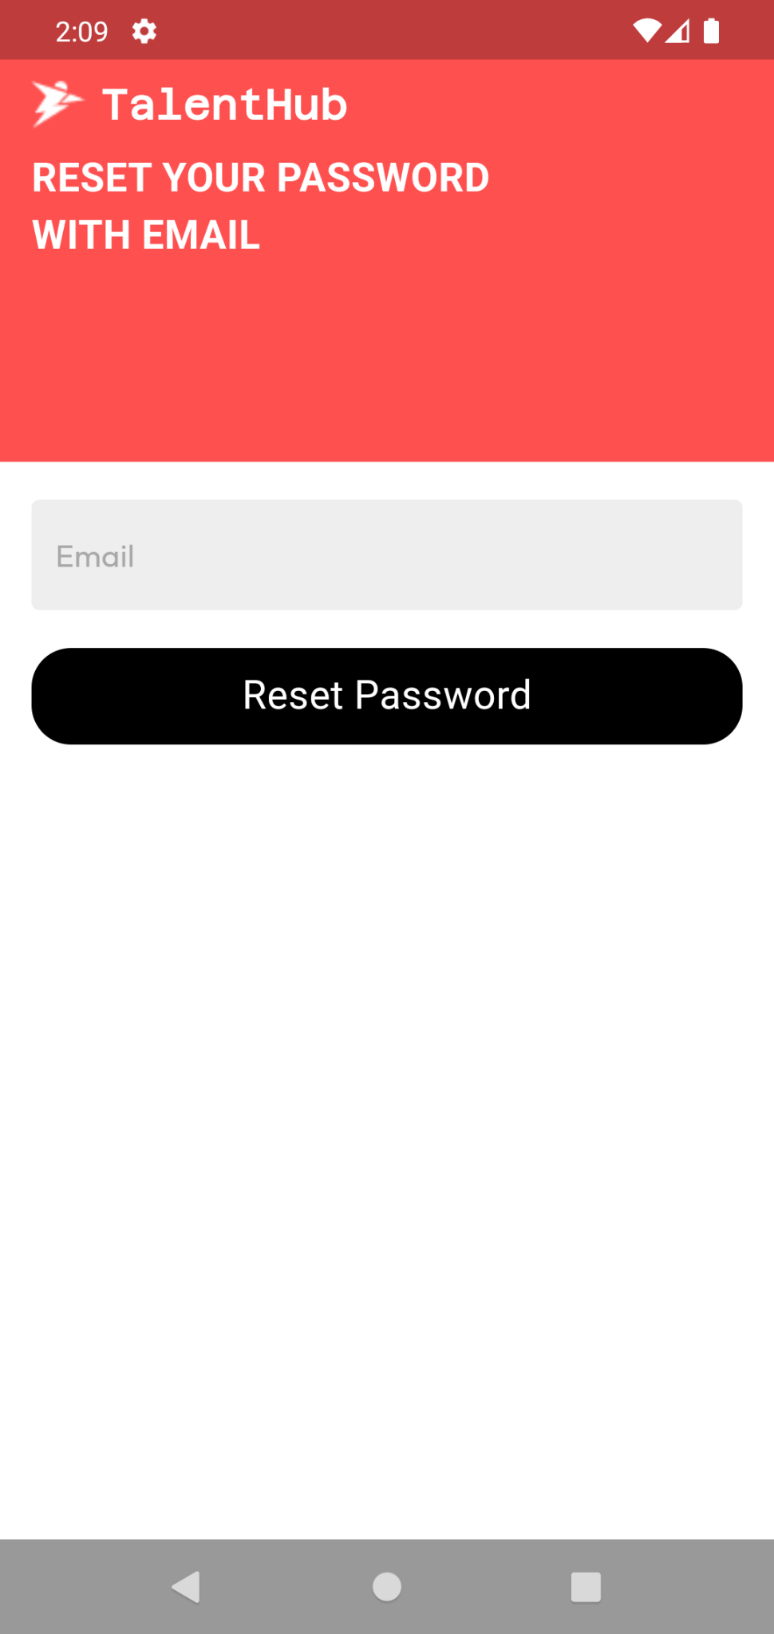
TalentHub
Authentication

Slide 7
TalentHub
Authentication by Moaaz Ahmed
Login
If the user has an account, he will type his mail and password then he will be navigated to other screens depending on is role.

Slide 8
TalentHub
Authentication by Moaaz Ahmed
Register
Here the user sign up if he doesn’t have an account, he enters his name, email, password, age, phone, position, and most importantly his role whether he is player or scout. Also he may choose a profile picture for his account.

Slide 9
TalentHub
Authentication by Moaaz Ahmed
Password Reset
If the user forgets his account password, he can reset it by typing his email and a mail will be sent to his mailbox so that he can reset his password.

Slide 10
TalentHub
Player & Scout

Slide 11
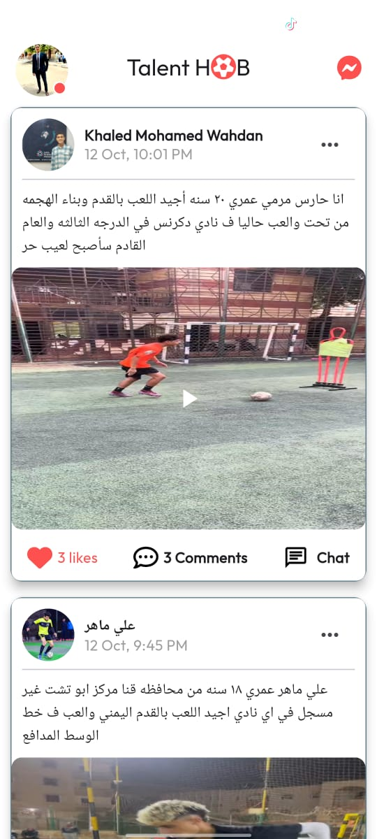
TalentHub
Scout Home Page by Eslam Elsayed
Scout Home
In this page, the scout can see the talents of unknown players who are marketing themselves and can communicate with them personally. The scout can also leave likes and comments on their posts.

Slide 12
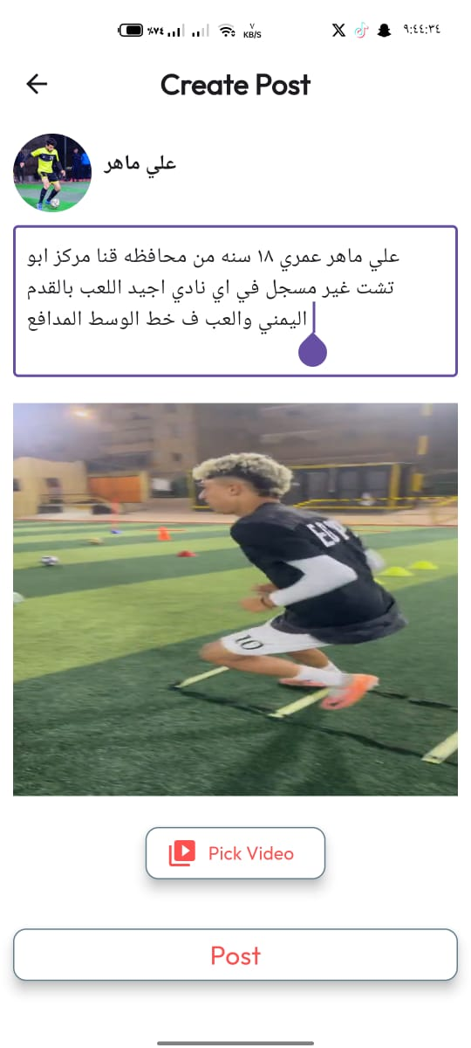
TalentHub
Upload Post Page by Eslam Elsayed
Upload Post
In this page, the player can upload posts to the app, and all users of the app can see and react to them. The post contains a video of the talent and a description that the player wrote, as well as the date of publication and the player's profile.

Slide 13
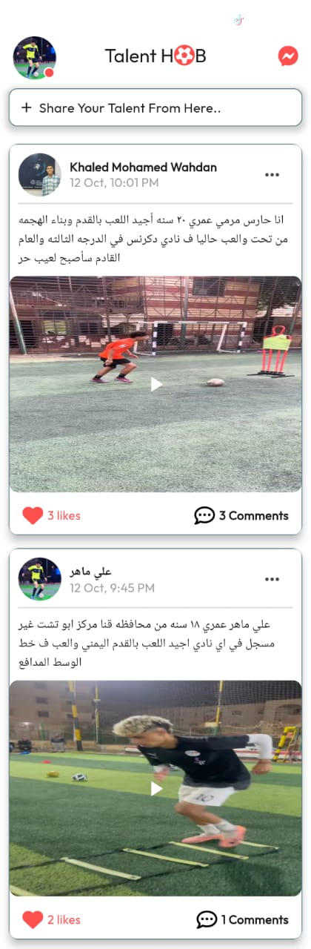
TalentHub
Player Home Page by Abdelrahman Hassan
Player Home
In this page, the player can see the talents of other players who are marketing themselves, and leave likes and comments on their posts. The player can also go to the upload post section to share their talent.

Slide 14
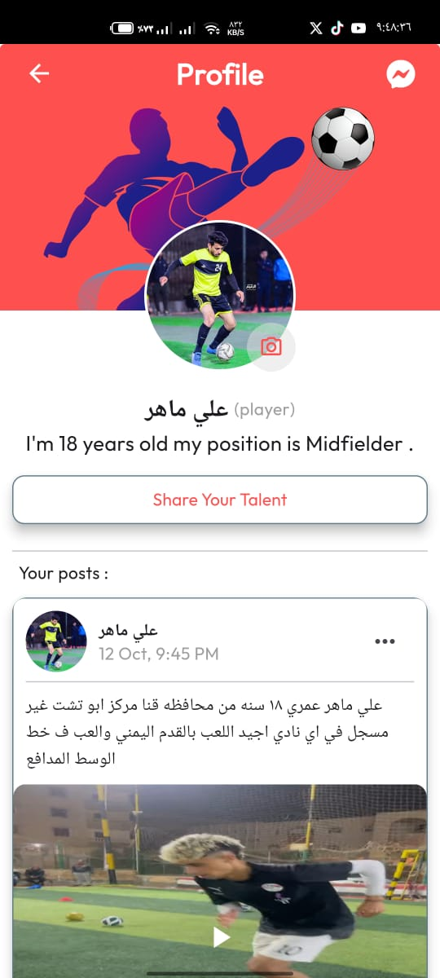
TalentHub
Profile Page by Abdelrahman Hassan
Profile Page
In this page, the scout and player can see their information and change the profile image. The player can see the posts they uploaded.

Slide 15
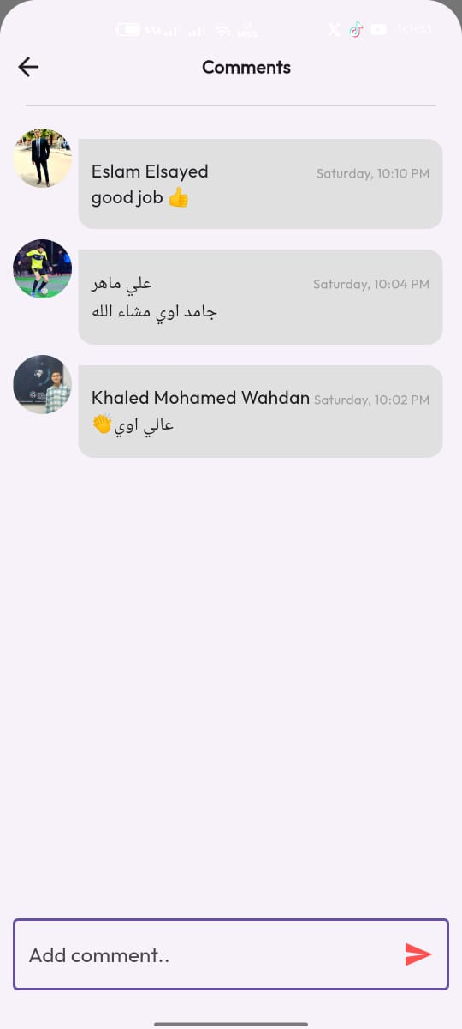
TalentHub
Comments Page by Eslam Elsayed
Comments Page
In this page, the scout and player can leave a comment to the player to encourage them and tell them their weak points.

Slide 16
TalentHub
Chat

Slide 17
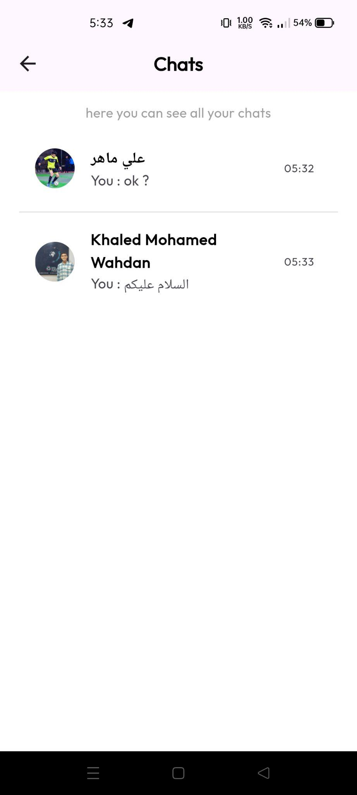
TalentHub
Chat Inbox Page by Eslam Elnady
Chat Inbox Page
This page allows players to view messages from scouts interested in them, while scouts can easily track the players they've reached out to.

Slide 18
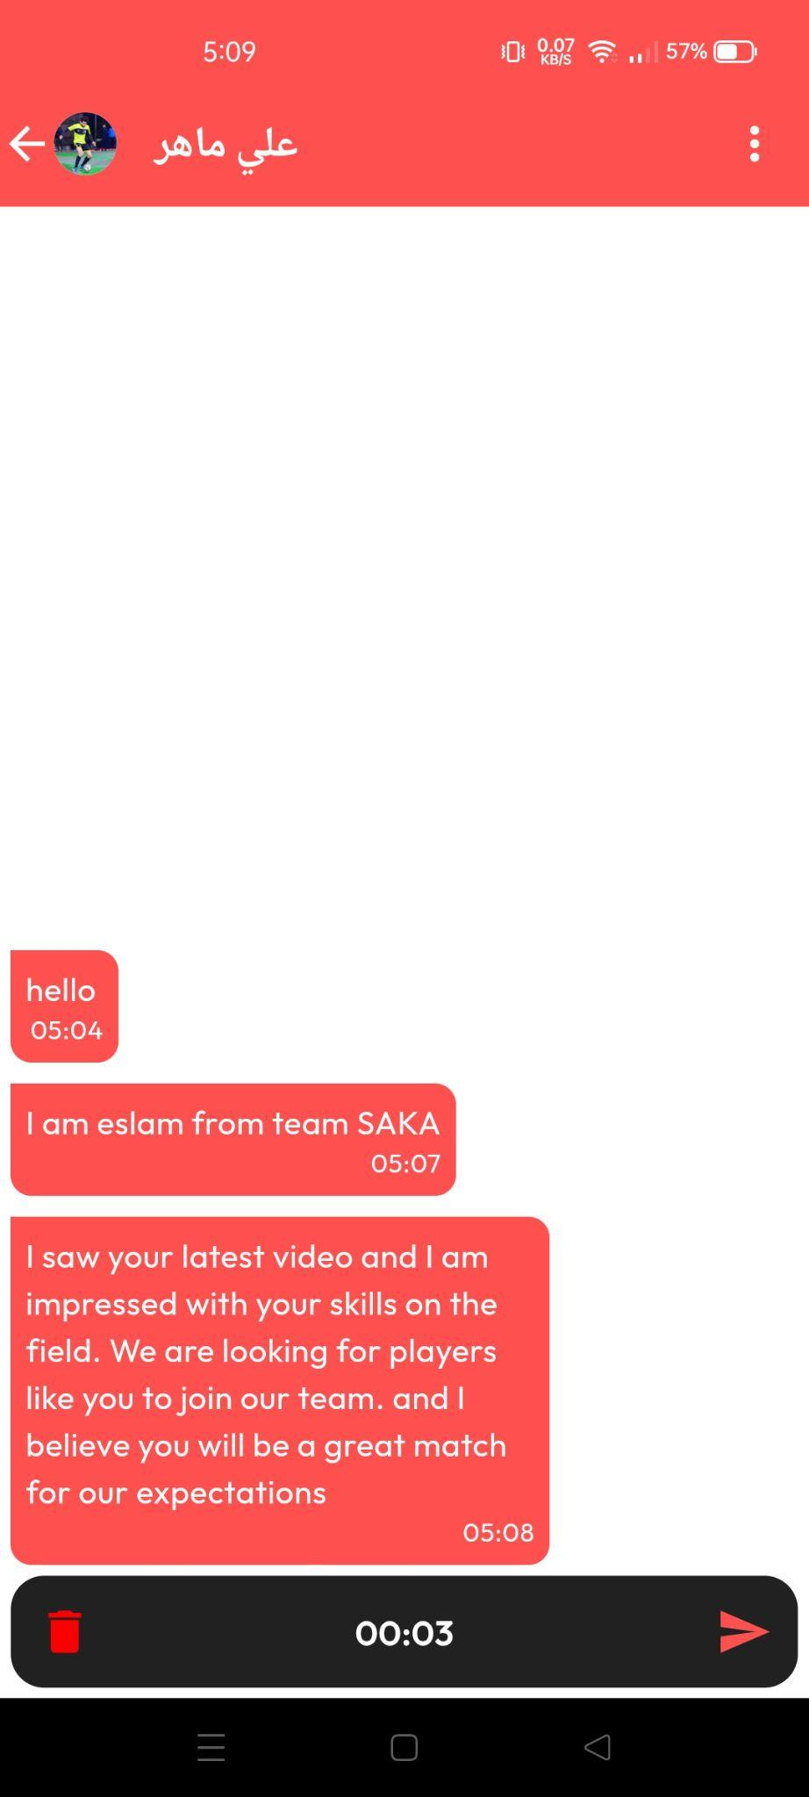
TalentHub
Chat Page by Eslam Elnady
Chat Page
The chat page supports real-time communication between players and scouts, with features for sending texts, images, voice messages, videos, and file sharing, ensuring versatile and dynamic interaction.

Slide 19
TalentHub
Thank
You

